Slide 1
Model Building
Expanding the Scikit-Learn libraries
Jeremy Bergmann - Omaha Data Science Academy

Slide 2
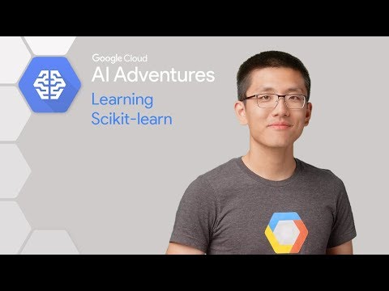
Scikit-Learn Intro
Scikit-Learn: Python Machine Learning (ML) Libraries that assist with the CRISP-DM process, Including:
Dataset Load/Preprocessing
Data Understanding
Model Building
Model Evaluation & Testing
Automation/Deployment
Juypter Notebook Example - Google Drive
scikit-learn - zoo-animal-classification.ipynb

Slide 3

Scikit-Learn Overview
Adheres to the CRISP-DM Process, by providing the following capabilities:
1) Data Preprocessing: Feature extraction and normalization.
2) Data Transformation: Dimensionality Reduction
3) Model Selection: Comparing, validating and choosing parameters and ML models. Models Include: Classification, Regression & Clustering
4) Model Testing & Validation:
“Simple and efficient tools for data mining and data analysis”
Notes:
Unstructured data - information that either does not have a pre-defined data model or is not organized in a pre-defined manner. Unstructured information is typically text-heavy, but may contain data such as dates, numbers, and facts as well. (80-90% of firm’s data)

Slide 4
Scikit-Learn Libraries
Preprocessing
Feature extraction and normalization.
Application: Transforming input data such as text for use with machine learning algorithms.
Modules: preprocessing, feature extraction.
Dimensionality Reduction
Reducing the number of random variables to consider.
Applications: Visualization, Increased efficiency
Algorithms: PCA, feature selection, non-negative matrix factorization.
Classification
Identifying to which category an object belongs to.
Application: Spam detection, Image recognition.
Algorithms: SVM, nearest neighbors, random forest, …
Regression
Predicting a continuous-valued attribute associated with an “known” object/target.
Applications: Drug response, Stock prices.
Algorithms: SVR, ridge regression, Lasso
Clustering
Automatic grouping of similar objects into sets, having previously “unknown” groups.
Applications: Customer segmentation, Grouping experiment outcomes
Algorithms: k-Means, spectral clustering,mean-shift,
Model selection
Comparing, validating and choosing parameters and models.
Goal: Improved accuracy via parameter tuning
Modules: grid search, cross validation,metrics.

Slide 5
Scikit-Learn - Zoo Animal Classification
Purpose: Explore all key features/libraries in the Scikit-Learn data science package
Analysis: Supervised Classification of 100 zoo animals into 7 groups of animal species, using various “predictive” ML models.
Packages Used:
Pandas (Importing Data, Data Quality, Exploratory Data Analysis)
Numpy, Matplotlib & Seaborn (Exploratory Data Analysis)
SKLearn Model Building (Linear Models, Decision Tree, SVC)
SKLearn Model Selection (Model Selection & Comparison - Train/Test)
SKLearn Metrics (Model Evaluation)

Slide 6
Gensim Word2Vec to Scikit-Learn
Purpose:
Re-factor Gensim Model to utilize Scikit-Learn features.
Improved usage when integrating with Jupyter Notebooks & Dataiku
Improved Data Understanding and Model Performance
Model Deployment
Steps:
Port/Generalize code by utilizing the “sklearn_api” library within Gensim.
Leverage SciKit-Learn data exploration packages and graphical libraries.
Leverage SciKit-Learn data transformations, models and model selection packages.
Improved Portability w/Dataiku

